Slide 1
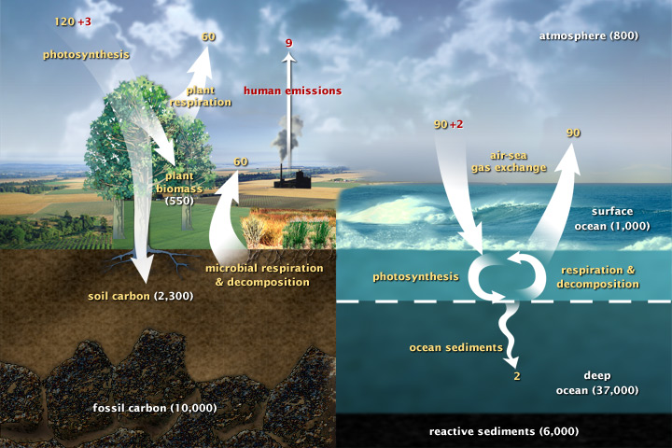

Slide 2
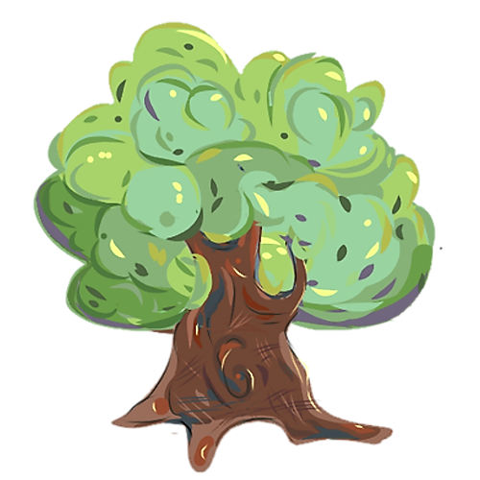
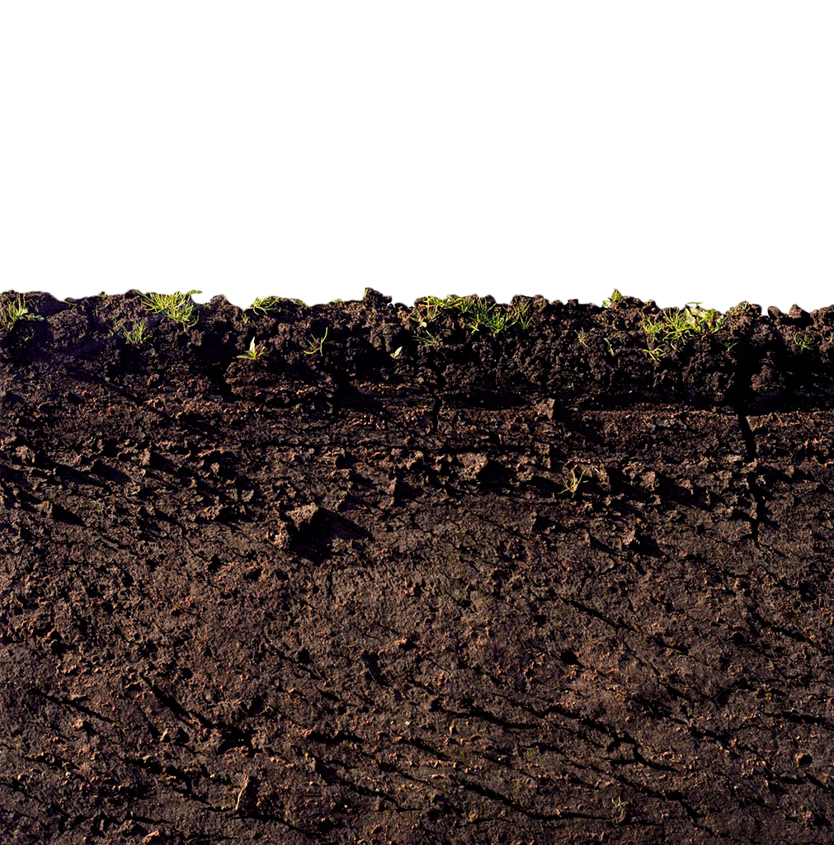

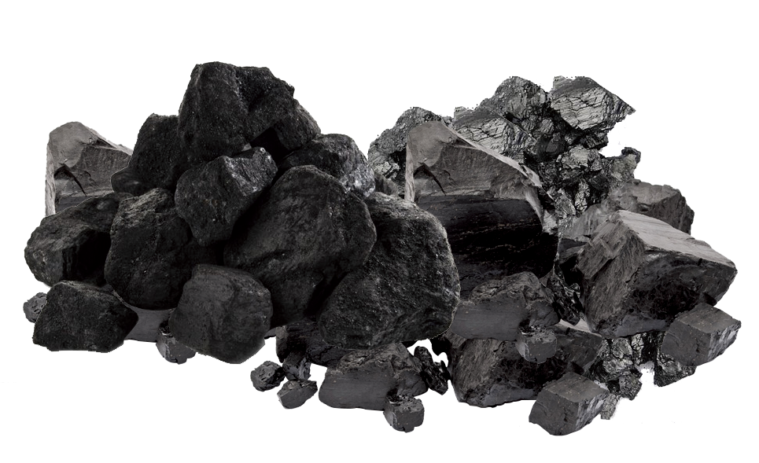

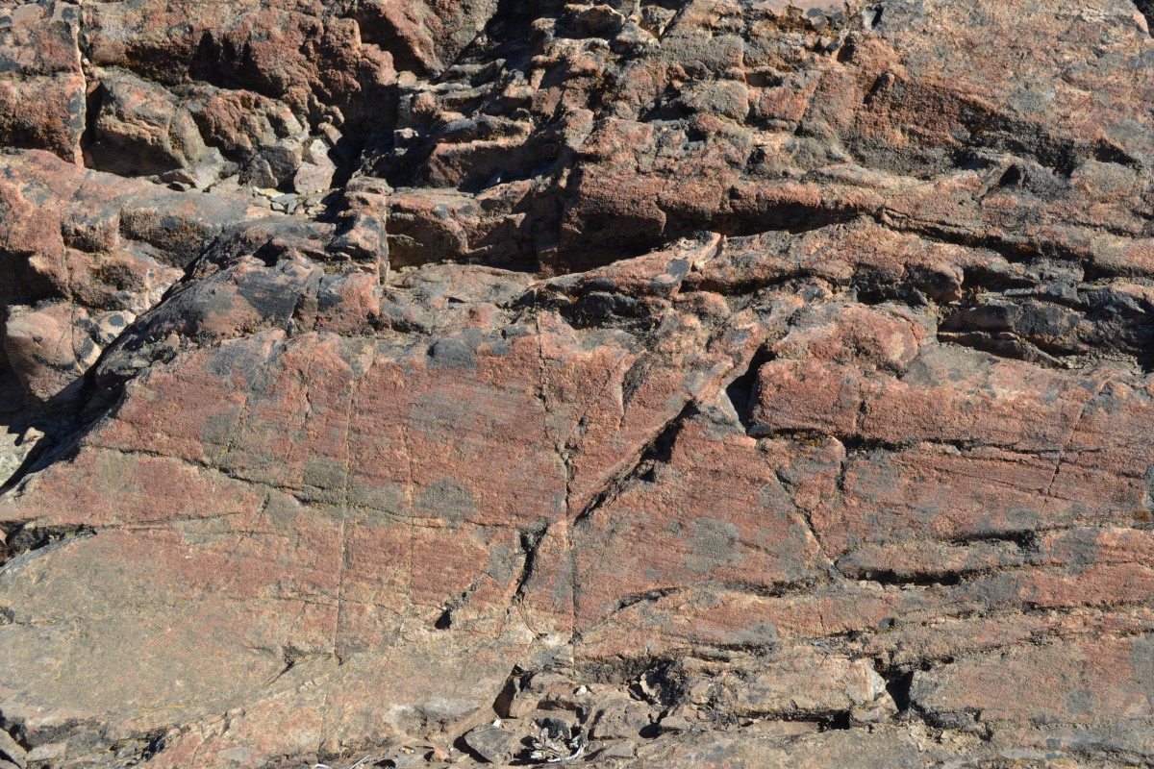
1,300 GtC
750 GtC
550 GtC
1,400 GtC
1,400 GtC
10,000 GtC
10,000 GtC

Slide 4
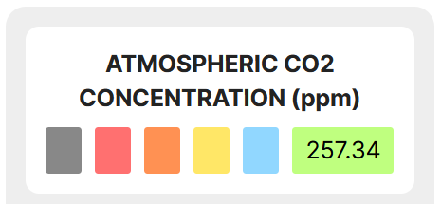
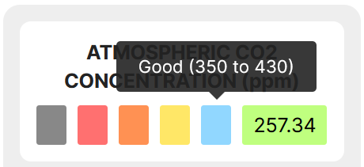


Slide 5

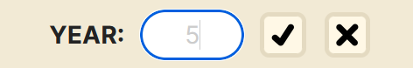
Play Pause Button
Text Box & Display
Reset Button
Confirm
Button
Cancel
Button
Active Text Box

Slide 6
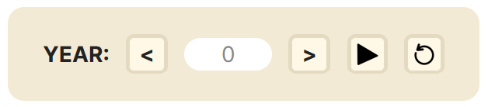
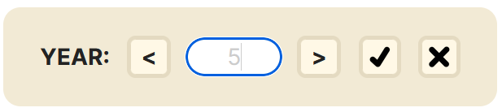
Cancel
Button
Play Pause Button
Text Box
& Display
Reset Button
Confirm
Button
Back
Button
Next
Button

Slide 7
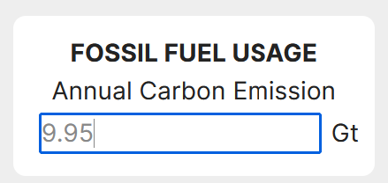
Text Box

Slide 8
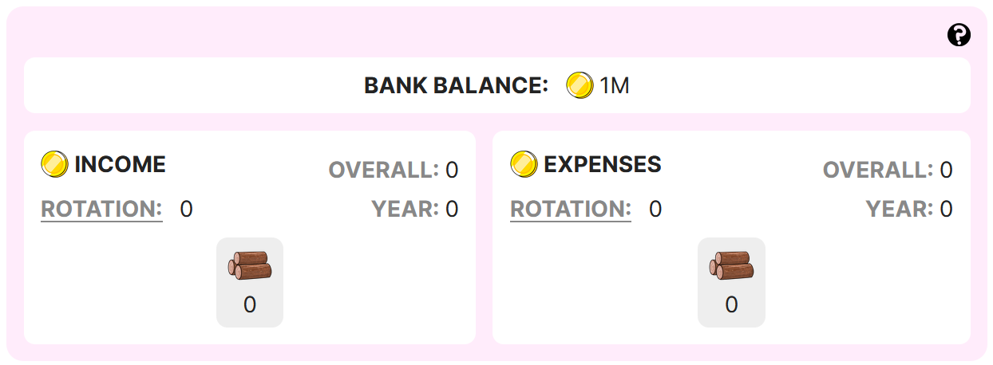

A Coin

Slide 9
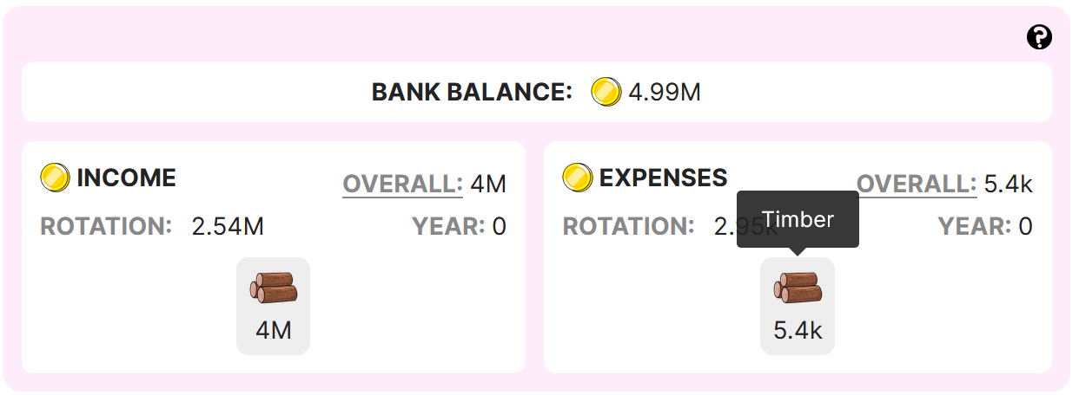



Slide 10
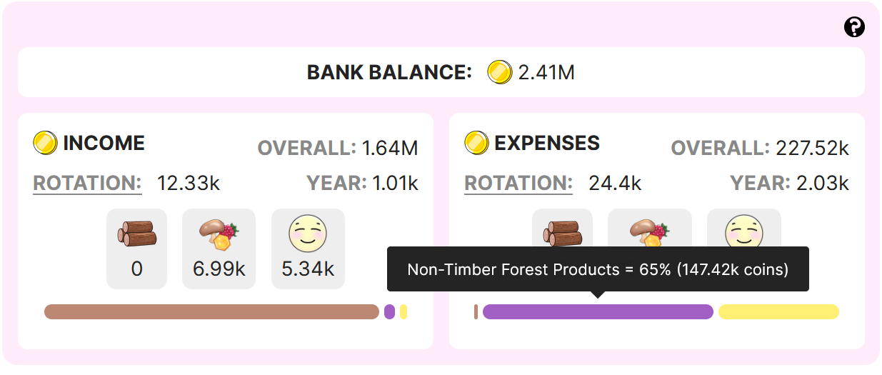

Slide 12
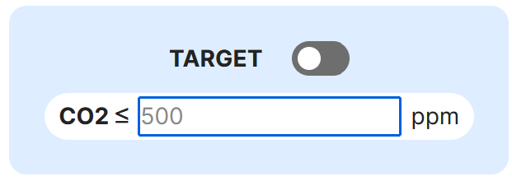
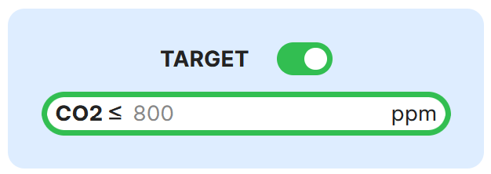
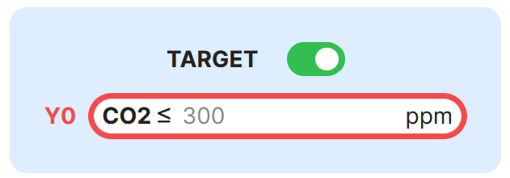
Success
Condition
View
Switch
Text Box
Target Met
Failed to meet target at year 0.

Slide 13
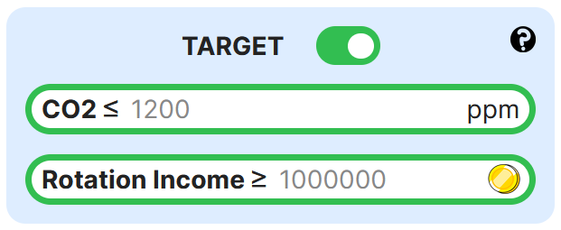
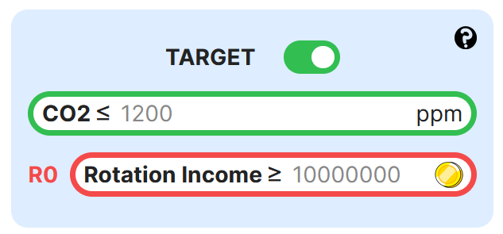

Slide 14



TIMBER
NTFP
RECREATION

Slide 15
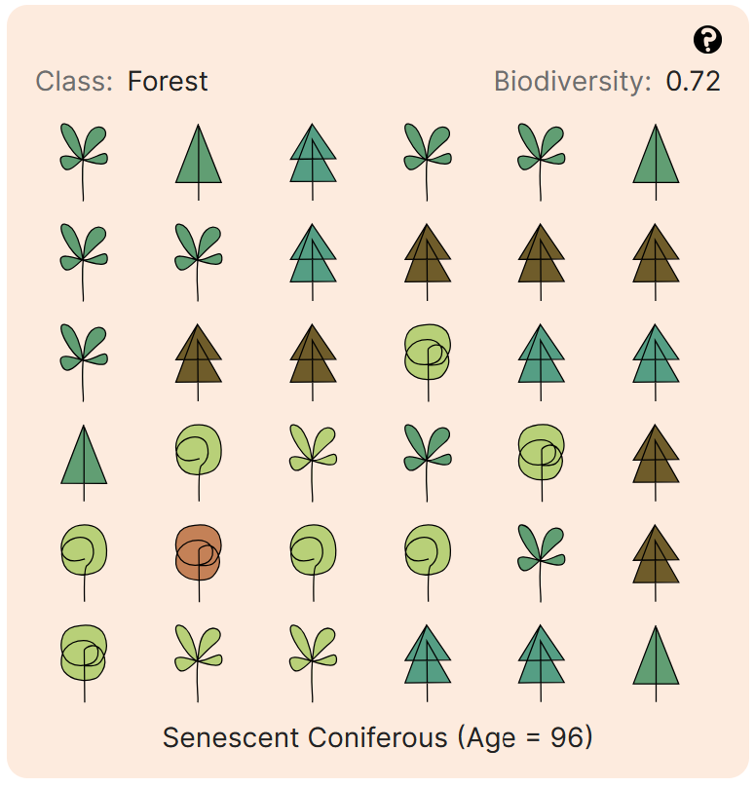
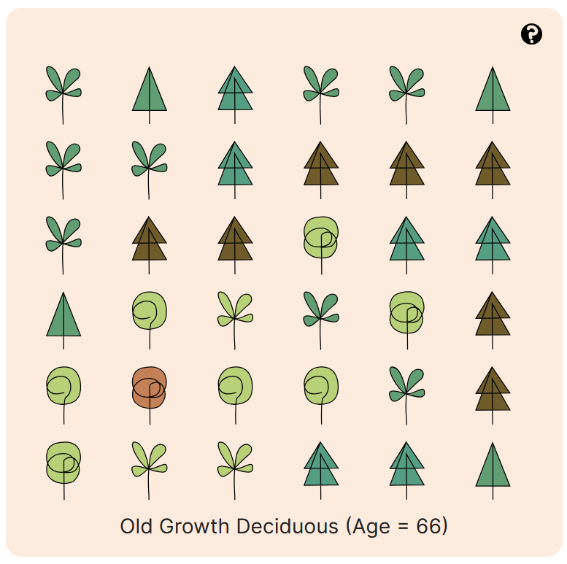

Slide 16









TREE LIFE STAGE
Deciduous
TREE TYPE
Coniferous
Old
Growth
Dead
Seedling
Sapling
Mature
Senescent

Slide 17




TREE LIFE STAGE
Deciduous
TREE TYPE
Coniferous
Old
Growth
Dead
Seedling
Sapling
Mature
Senescent

Slide 18
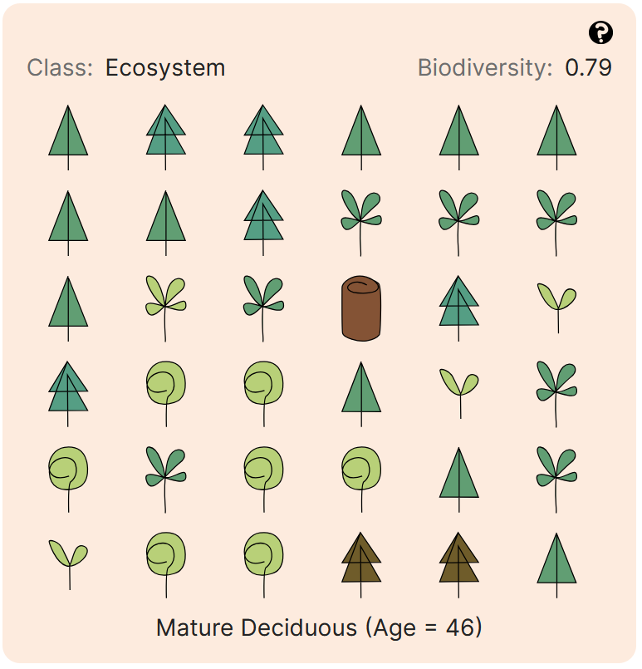
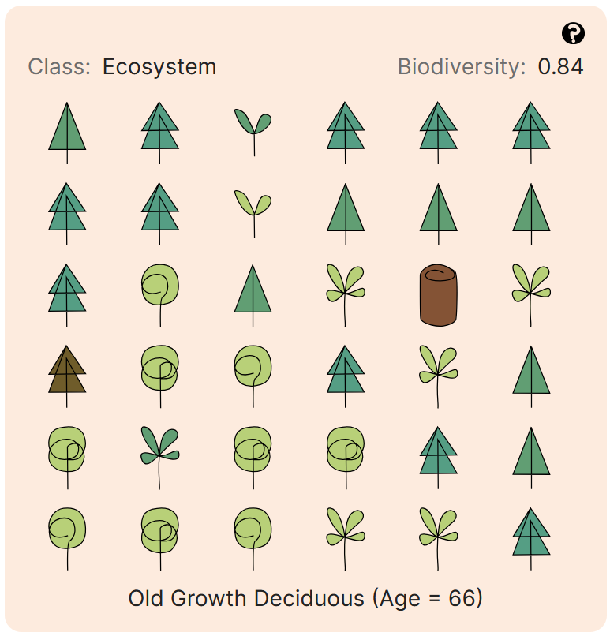
TREE LIFE STAGE
Deciduous
TREE TYPE
Coniferous
+20 Years
Old
Growth
Dead
Seedling
Sapling
Mature
Senescent

Slide 19

TREE LIFE STAGE
Deciduous
TREE TYPE
Empty Land
Coniferous
Old
Growth
Dead
Seedling
Sapling
Mature
Senescent

Slide 20
TREE LIFE STAGE
Age 1
Age 4
Age 21
Age 47
Age 70
Age 80
Deciduous
TREE TYPE
Empty Land
Coniferous
Age 1
Age 3
Age 26
Age 60
Age 90
Age 100
Old
Growth
Dead
Seedling
Sapling
Mature
Senescent

Slide 21
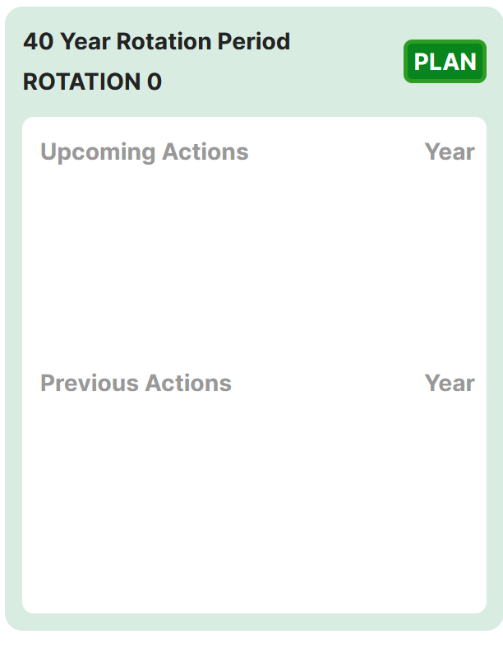
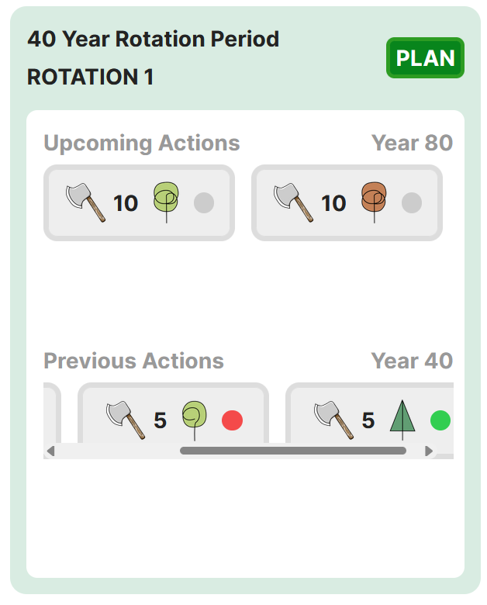
Rotation Period Display
Next Planned Actions with Year
Plan Button
Rotation Display
Last Processed Action(s) with Year

Slide 22
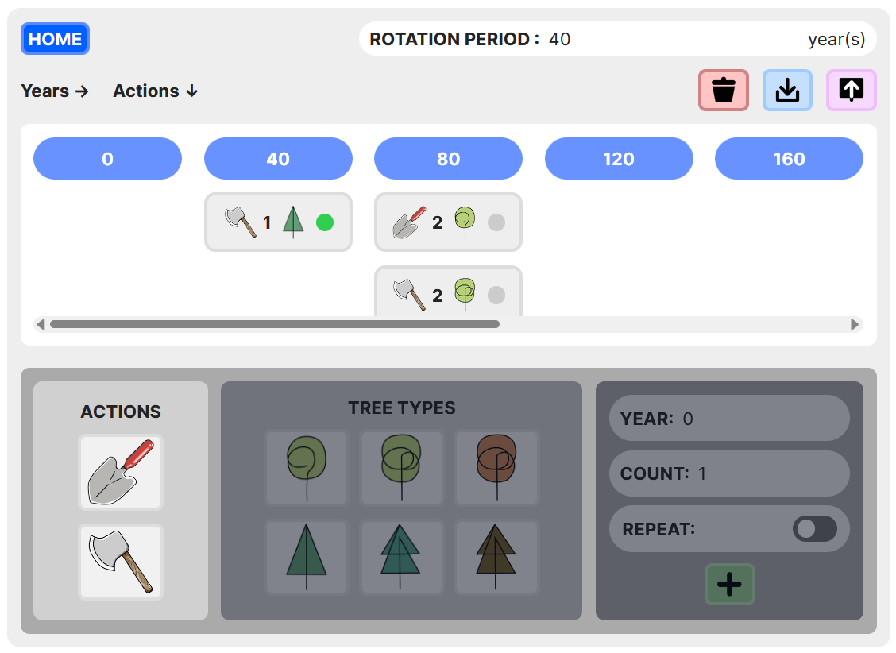
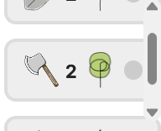
Rotation Period Display/Textbox
Save
Button
Home Button
Delete Button
Load
Button
Year Tag
Action Tag
Action
Picker

Slide 23
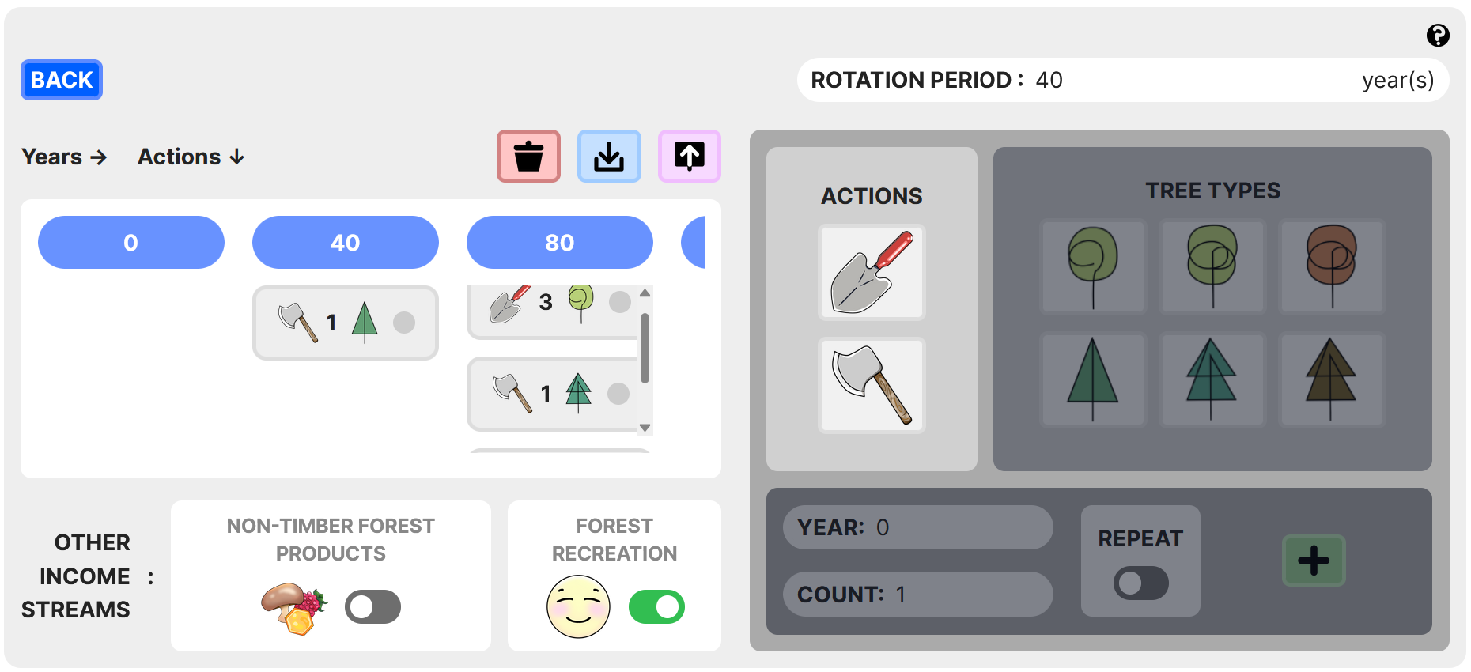
Rotation Period Display/Textbox
Back Button
Delete
Button
Save
Button
Load
Button
Year Tag
Action Tag
Action
Picker
Income Stream Activation Switch

Slide 24
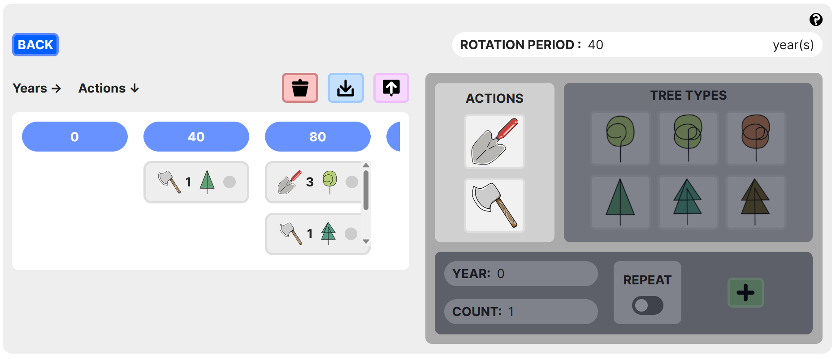
Rotation Period Display/Textbox
Back Button
Delete
Button
Save
Button
Load
Button
Year Tag
Action Tag
Action
Picker

Slide 25
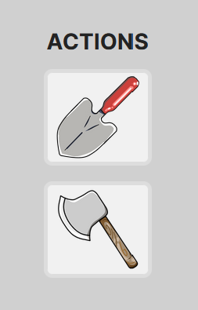
Plant a Tree
Fell a Tree

Slide 26
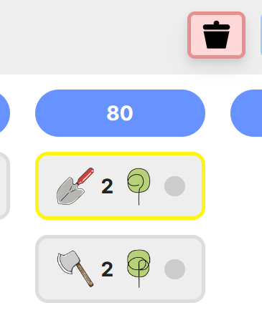
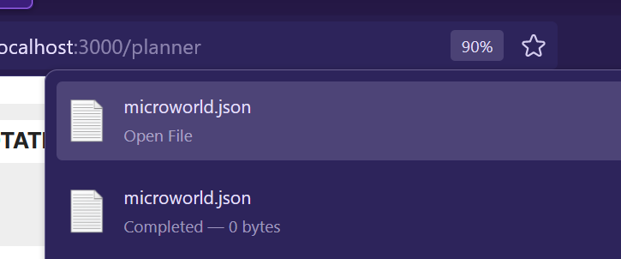
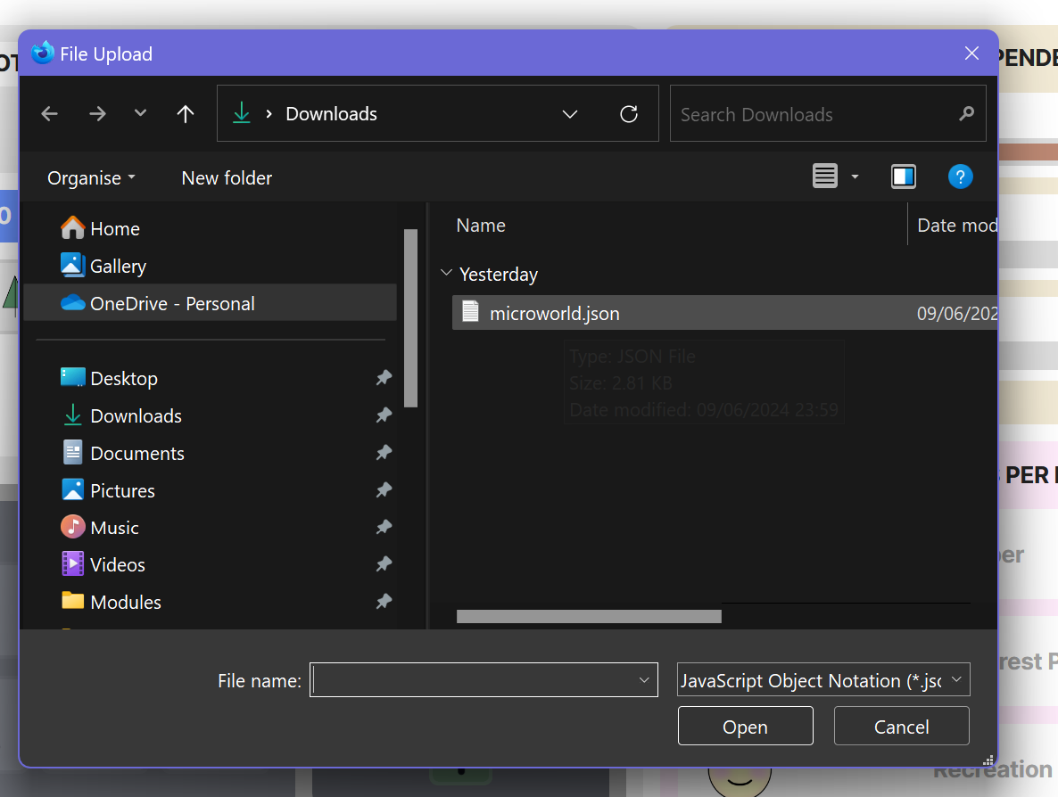
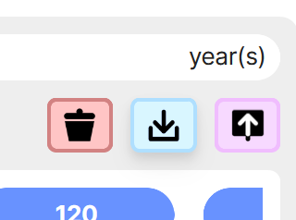
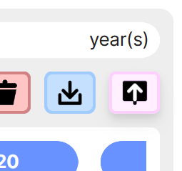
Delete Actions
Save Settings
Load Saved Settings

Slide 27
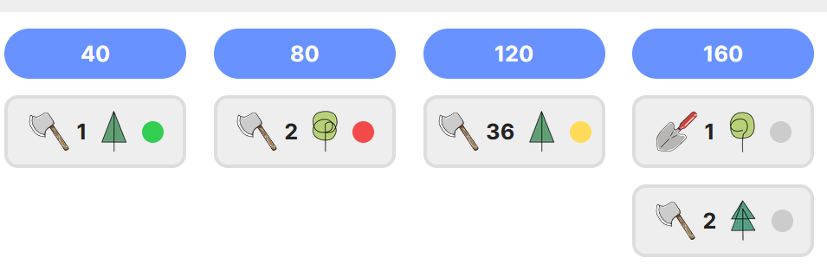
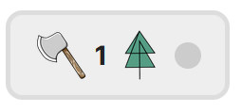
Tree Type
Action Type
Action Execution Status
Action could not be executed at all.
Maximum No. of trees to apply action to.
Action yet to be processed.
Action Successfully Executed for all planned no. of trees.
Action was executed for one or more trees as were available on land at year 120, but it could not be executed for all planned no. of trees.

Slide 28
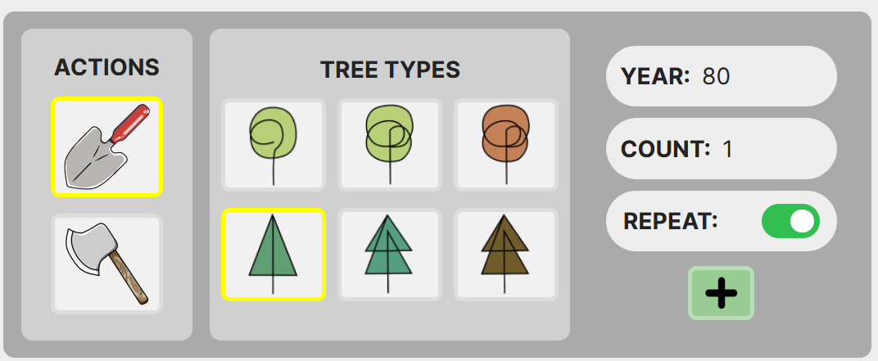
Year Text Box
Plant Tree
Count Text Box
Repeat Switch
Fell Tree
Action
Type Button
Tree Type Button
Add Button

Slide 29
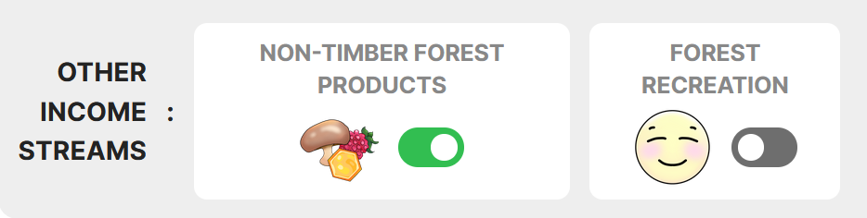
Dependency Switch

Slide 30
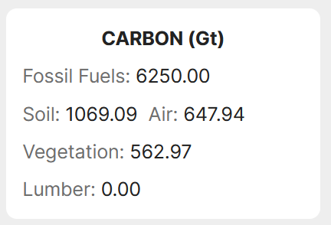

Slide 31
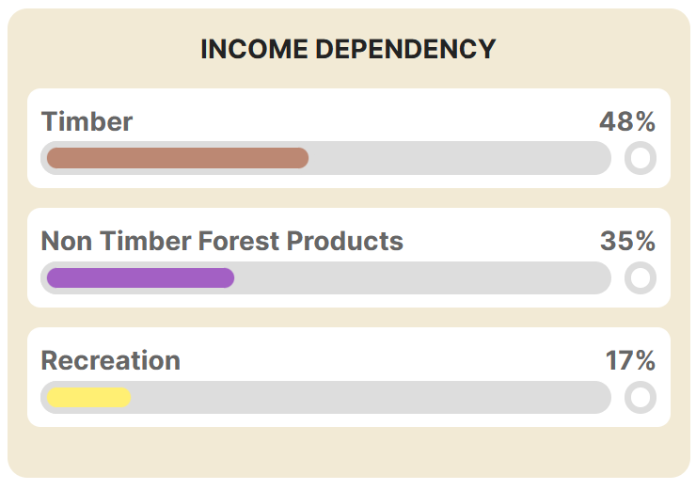
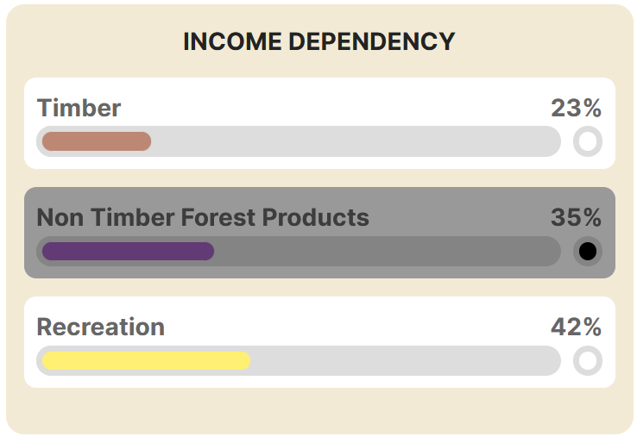
Slider Lock Toggle
Dependency Sliders

Slide 32
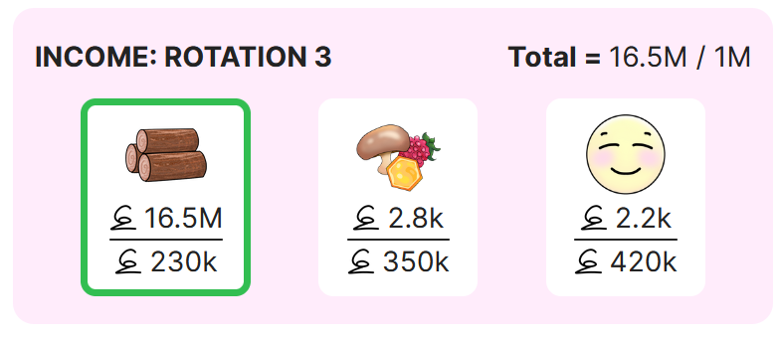
Current Rotation Display
Total/target income this rotation so far.
Income so far/expected income this rotation.

Slide 33
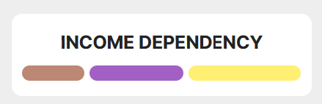
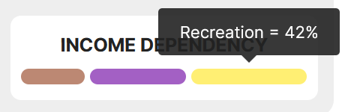

Slide 36
UI COMPONENTS
LANDING HELP WORLD PLANNER
HOME
APP PAGES
SIMULATION MODEL
INPUT VARIABLES

Slide 37



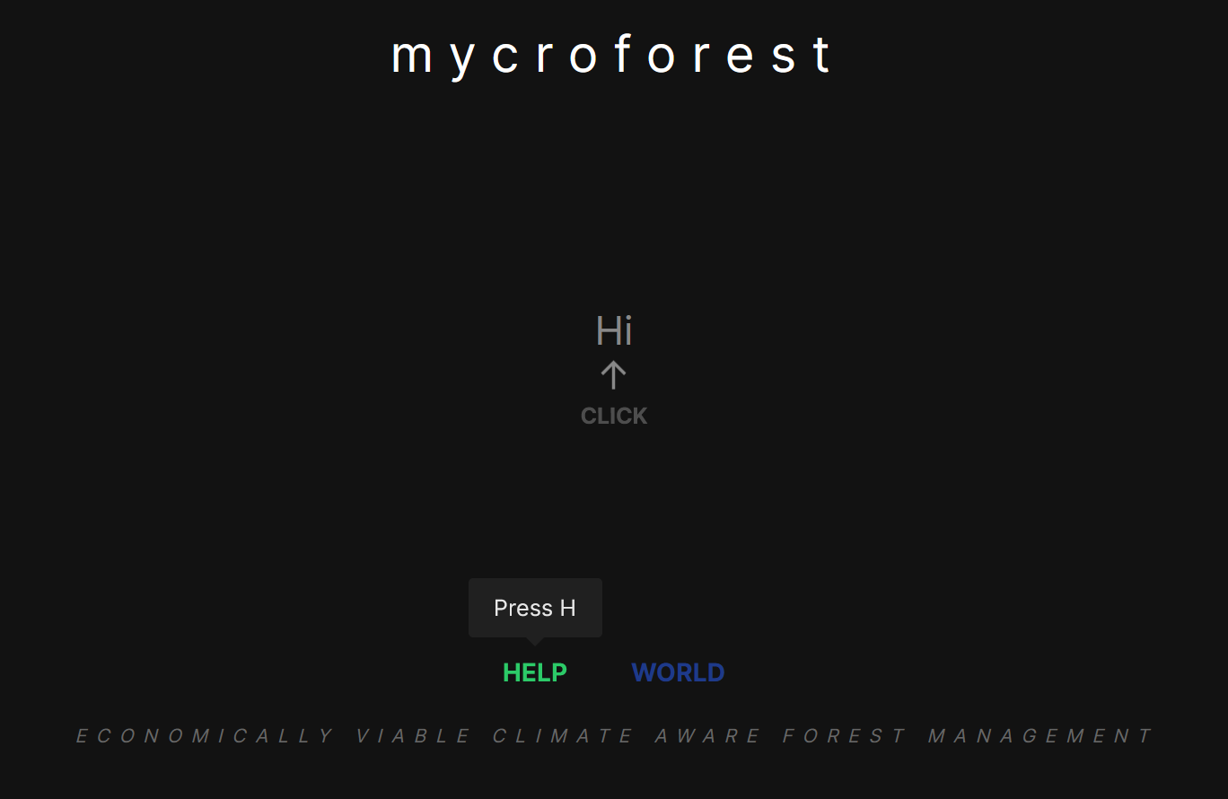


Cursor Torch
PRESS ENTER

Slide 38
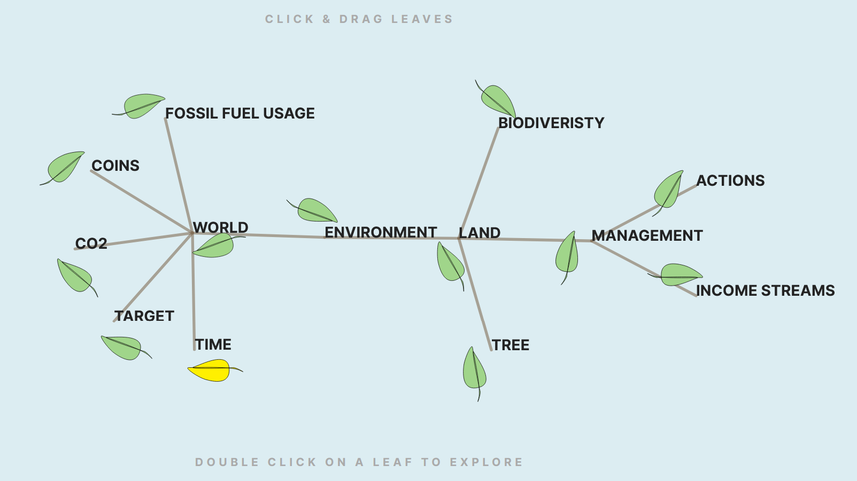
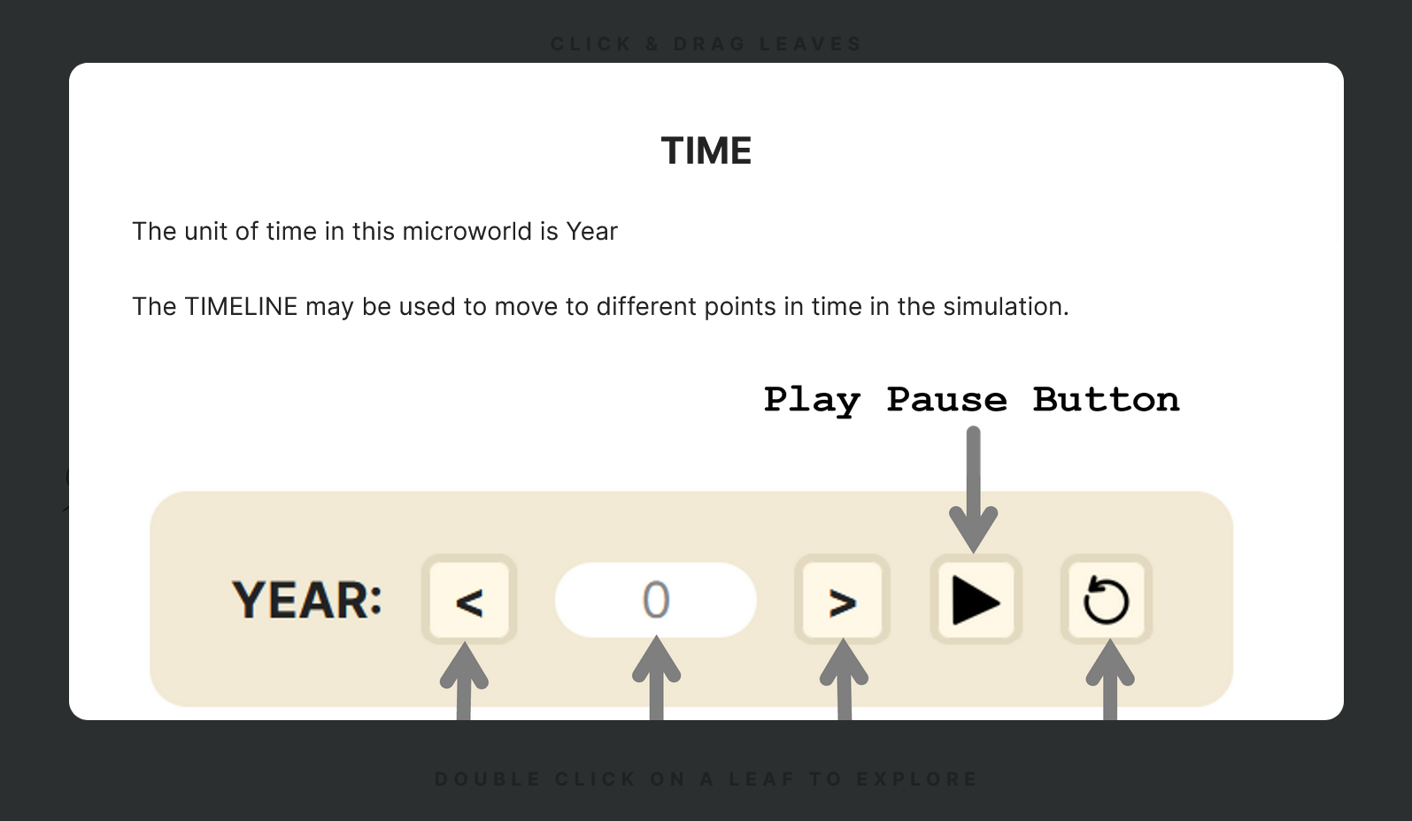
Double Click

Slide 39
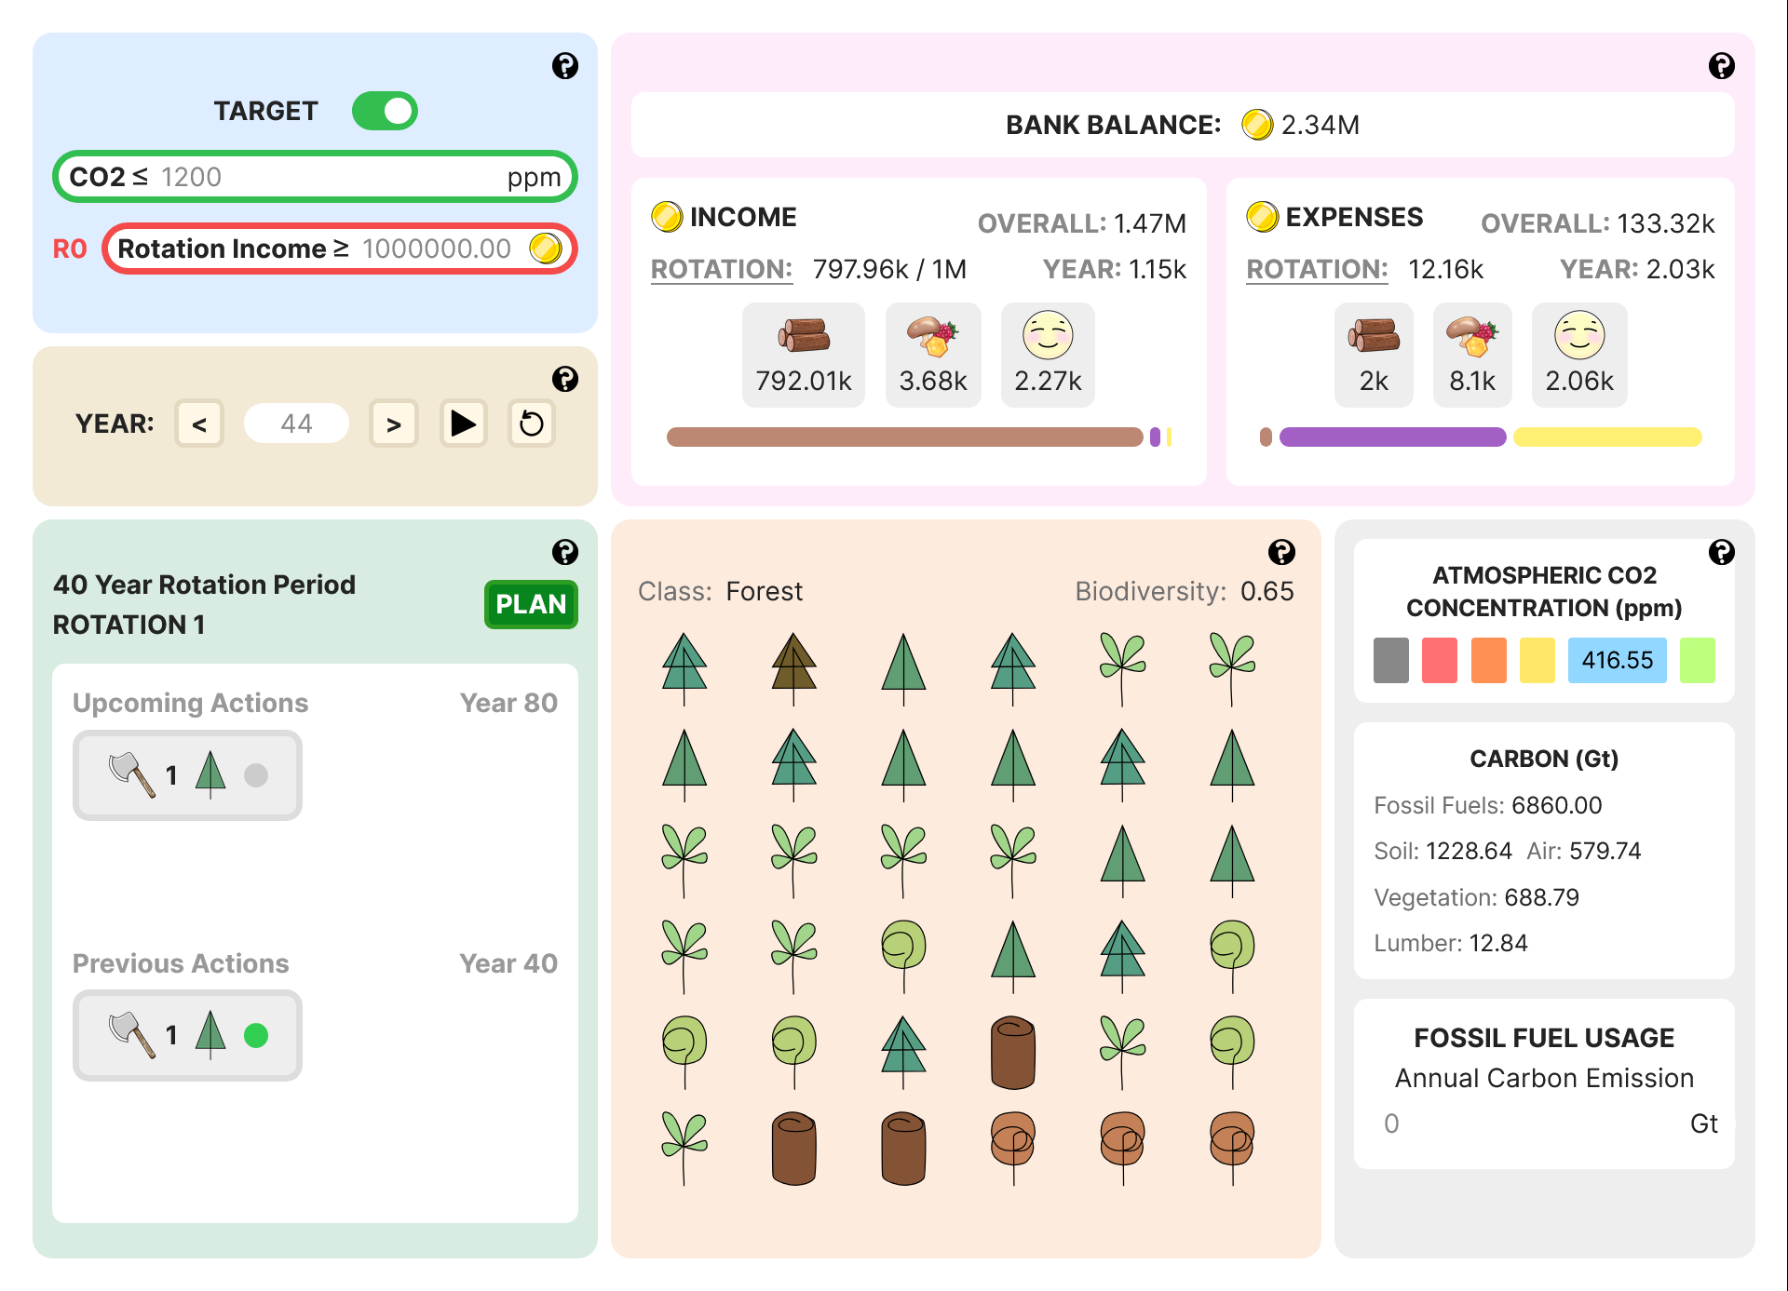

Slide 42
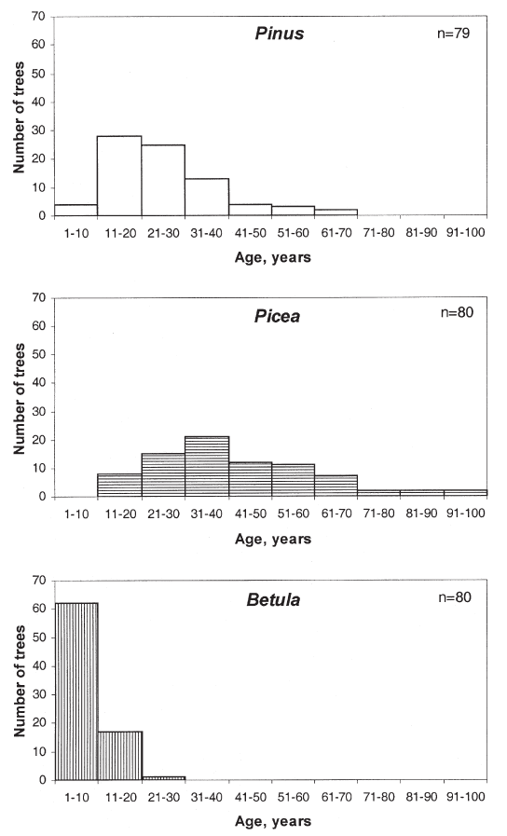

Slide 43

Pink and white colour for separation & colour coded bars.
Size of stacked bars hint at contribution proportions revealed on hover.
Time level data separated using position.

Slide 44



Action Num Trees Affected
Is Action Successful
Action Type
Action Tree Affected
PART OF PLANNER
PLAN VIEWER

Slide 45



Year 0
Year 20
Hover reveals legend.

Slide 46



From action picker in planner page.

Slide 47






Challenges 1 to 4
Challenge 1
Challenge 3
Challenges 1 to 4
Challenge 5
Challenge 2
Challenges 4 & 5

Slide 48
MAIN INTERFACE
INDICATORS INTERFACE
PLOT SPECIFIC SILVICULTURAL OPERATIONS DECISION INTERFACE

Slide 49


Slide 50


MAIN INTERFACE
CONCEPTUAL MODEL

Slide 51


FOREST MANAGEMENT INTERFACE
COMMUNITY DECISION MAKING INTERFACE

Slide 52








Slide 53



LAND OVERHEAD VIEW
LAND ORTHOGOANL VIEW

Slide 54


PROPERTIES
EDITOR
SUMMARY VIEWER

Slide 55

EQUATIONS VIEWER & EDITOR

Slide 56




Slide 57








Botany /Carbon Cycle Expert & Co-Supervisor
Supervisor
Research
Plant Growth + Carbon Flow
EduTech & Pedagogy
Development
HCI
Conceptual Model
Guides
MycroForest
Plant growth and carbon flow simulation.
NFRs like friendly UI.
FRs like creation, execution and evaluation of forest management plans.
Inputs
Informative
Microworld
+ Good UX.
Learners
Simulation Hyperparameters
Outputs
Researcher & Developer
Educators
Tool Art
UI
Elements
Enablers
Code
Reference Manager
Code Editor
CICD
Graphics Creators
Content Managers
MS Office
Obsidian
VS Code
UMLet
EndNote
FireAlpaca
Tech
Stack

Slide 58














VERSION CONTROL
GitHub
HOSTING
Big.js
Deployment
OPTIMIZATION
CLOUD
HOST
SIMULATION MODEL
STATE MANAGEMENT
VARS
CI-CD
ORGANIZATION
+ INTERACTION
VERSION
CONTROL
Client Side
WEB PAGES
ROUTING
OPTIMIZATION
LEARNER
VISUALIZATION
INTERACTIVE
COMPONENTS
file-saver.js
STRUCTURE
STYLE
ACTION
3rd PARTY PACKAGE
react-tooltip.js

Slide 59

}
… }
]
}

Slide 60



Slide 61





Slide 62




Slide 63


Slide 64



EARLY PROTOTYPE
…
CURRENT
VERSION
…

Slide 65



Slide 66


Deployment
& Analysis
Planning
Building

Slide 67


Vercel
GitHub

Slide 68



PROJECT TIMELINE
19 Jan 2024 – 05 Feb 2024
Terminal
Terminal

Slide 69


PROJECT TIMELINE
19 Jan 2024 – 05 Feb 2024

Slide 70


PROJECT TIMELINE
06 Feb 2024 – 15 Feb 2024

Slide 71



PROJECT TIMELINE
16 Feb 2024 – 15 May 2024
Planner Page
Action Picker
Home Page

Slide 72

PROJECT TIMELINE
16 May 2024 – 26 May 2024

Slide 73


PROJECT TIMELINE
27 May 2024 – 01 June 2024

Slide 74




PROJECT TIMELINE
02 June 2024 – 11 June 2024

Slide 75



PROJECT TIMELINE
12 June 2024 – 18 June 2024
Bridge To College Version

Slide 76

PROJECT TIMELINE
20 June 2024 – 27 June 2024

Slide 77


PROJECT TIMELINE
27 June 2024 – 30 July 2024

Slide 78


Slide 79



Slide 80



MycroForest

Slide 81








Slide 82






Tree Stress Over Time
Tree Carbon Absorbed Over Time
CO2 Concentration Over Time

